Slide 1

PREDICTIVE ANALYSIS
Aman Kumar
amnkr301@gmail.com

Slide 2
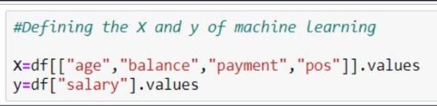
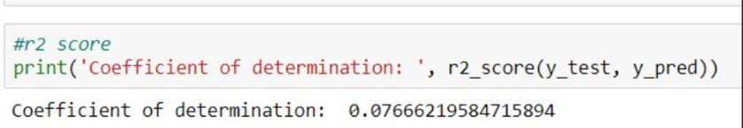
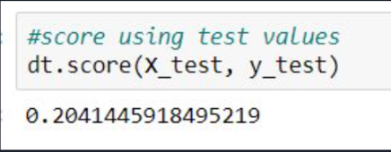
Supervised Model:
Took these columns as X and y. The r2 score was low, main reason being lack of data, hence less training example
Decision Tree Regressor:
This model also gave very low score.
But the sample prediction it made was also in realistic values.

Slide 3
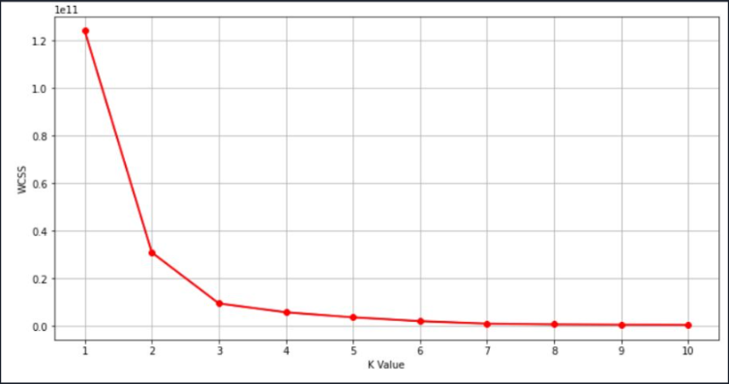
Unsupervised Model:
Custom Segmentation using K-means:
The elbow curve shows that the elbow is formed at k=3. So we can make 3 clusters.
The customer segment have been made. The segment are based on customer age, account balance, average payment and POS transaction and salary

